Slide 1
Evaluation of freight transported on Road and Fuel consumption in Latvia
Group Members:
VISHNU SHARMA NANDA
Student ID No. 231AJG024
M.P AKILA SHEHAN
Student ID No. 231AJG021
SHENON RAVISHA WICKRAMATHILAKA
193AIB005
MADAN KRISHNA
241ACG071
MANOK KUMAR GOPAL
Student ID No. 241ACG058
Scientific adviser: Agnese Botenko
12/12/2024

Slide 2
The topicality of the theme
Road fright is one of the major mode of transportation in latvia, followed by rail way. Due to the increase in the transportation, the consumption of fuel also tend to be rising high. (Eng.LSM.lv,Latvian Public Broadcasting)
This study will be an analysis the road freight transport in Latvia by means of volume and its fuel consumption .
The time period of the data is from 2014-2023
https://eng.lsm.lv/article/economy/transport/05.12.2023-road-freight-figures-up-other-forms-of-transport-down.a534035/

Slide 3
The aim of the research, the object, the subject
The aim of the research is to analyze fright transportation on road and fuel consumption in Latvia
The object of the research is Evaluate trends in fuel consumption for road transportation in Latvia from 2014 to 2023.
The subject of the research is indicating the consumption of fuel and volume of freight transportation in Latvia

Slide 4
Research methods
Mathematical and statistical methods based on methods of averages, relative values, calculation and comparison, correlation and grouping pertaining to the gathered data from the mentioned sources have been followed.
To receive the maximum results of this study, the selected time frame will be from 2014 to 2023. The reason to choose this period is as it can be more effective to comprehend variations and time to time changes of the transportation in EU.
The theoretical aspects of freight transportation such as its historical development, its advantages and disadvantages comparatively to other means and the legal regulations of EU pertaining to road freight transportation have been discussed in order to provide an introduction.

Slide 5
FUEL CONSUMTION OF ROAD TRANSPORTATION IN LATVIA
Year | Fuel consumption (thousand toe)
2014 | 537
2015 | 562
2016 | 607
2017 | 668
2018 | 693
2019 | 754
2020 | 768
2021 | 791
2022 | 752
2023 | 795

Slide 6
TOTALFREIGHT TRANSPORTATION IN LATVIA
Year | Road Freight (in thousand tons)
2014 | 62,239
2015 | 62,569
2016 | 63,389
2017 | 68,013
2018 | 76,701
2019 | 73,755
2020 | 75,660
2021 | 81,562
2022 | 80,906
2023 | 80,624

Slide 7
CORRELATION AND COVARIENCE
CORRELATION
VALUE:0.935
INTERPRITATION: The correlation coefficient indicates a strong positive value suggests that there is a tendency for road freight volumes and fuel consumption to increase together. In other words, as more freight is transported by road, the consumption of fuel also tends to rise.
COVARIENCE
VALUE: 632375
INTERPRIATTION: This high positive value indicates a strong positive correlation between the two variables. It suggests that as road freight increases, fuel consumption also significantly increases.
covariance
 | Road Freight (in tons) | Diesel oil (thousand toe)
Road Freight (in tons) | 55502798.2
Diesel oil (thousand toe) | 632375.64 | 8235.21
correlation
 | Road Freight (in tons) | Diesel oil (thousand toe)
Road Freight (in tons) | 1
FUEL CONSUMPTION (thousand toe) | 0.93536336 | 1

Slide 8
SINGLE REGRESSION
SUMMARY OUTPUT
Regression Statistics
Multiple R | 0.93536336
R Square | 0.87490461
Adjusted R Square | 0.85926769
Standard Error | 35.8850033
Observations | 10
ANOVA
 | df | SS | MS | F | Significance F
Regression | 1 | 72050.2323 | 72050.2323 | 55.9511998 | 7.06E-05
Residual | 8 | 10301.8677 | 1287.73346
Total | 9 | 82352.1
 | Coefficients | Standard Error | t Stat | P-value
Intercept | -133.81089 | 111.0765 | -1.2046733 | 0.26275554
Road Freight (in tons) | 0.01139358 | 0.0015232 | 7.48005346 | 7.06E-05
 |  |  | 0.96134822
RESIDUAL OUTPUT
Observation | Predicted fuel consumption (thousand toe) | Residuals
1 | 575.314211 | -38.314211
2 | 579.074093 | -17.074093
3 | 588.41683 | 18.5831704
4 | 641.100749 | 26.8992507
5 | 740.088183 | -47.088183
6 | 706.522693 | 47.4773072
7 | 728.227465 | 39.772535
8 | 795.472382 | -4.4723815
9 | 787.998192 | -35.998192
10 | 784.785202 | 10.2147977

Slide 9
Testing If OLS Assumption Hold
SUMMARY OUTPUT
Regression Statistics
Multiple R | 0.93536336
R Square | 0.87490461
Adjusted R Square | 0.85926769
Standard Error | 35.8850033
Observations | 10
ANOVA
 | df | SS | MS | F | Significance F
Regression | 1 | 72050.2323 | 72050.2323 | 55.9511998 | 7.06E-05
Residual | 8 | 10301.8677 | 1287.73346
Total | 9 | 82352.1
 | Coefficients | Standard Error | t Stat | P-value
Intercept | -133.81089 | 111.0765 | -1.2046733 | 0.26275554
Road Freight (in tons) | 0.01139358 | 0.0015232 | 7.48005346 | 7.06E-05
 |  |  | 0.96134822
R-squared : 0.874 . indicates that approximately 87.49% of the variability in fuel consumption can be explained by road freight transportation. This is a strong indication that the model fits the data well.
OBSERVATION: 12
Standard Error: The standard error (35.8850) measures the average distance that the observed values fall from the regression line. A smaller standard error indicates a better fit of the model to the data.

Slide 10
Testing If OLS Assumption Hold
SUMMARY OUTPUT
Regression Statistics
Multiple R | 0.93536336
R Square | 0.87490461
Adjusted R Square | 0.85926769
Standard Error | 35.8850033
Observations | 10
ANOVA
 | df | SS | MS | F | Significance F
Regression | 1 | 72050.2323 | 72050.2323 | 55.9511998 | 7.06E-05
Residual | 8 | 10301.8677 | 1287.73346
Total | 9 | 82352.1
 | Coefficients | Standard Error | t Stat | P-value
Intercept | -133.81089 | 111.0765 | -1.2046733 | 0.26275554
Road Freight (in tons) | 0.01139358 | 0.0015232 | 7.48005346 | 7.06E-05
 |  |  | 0.96134822
=T.DIST.2T(0.05,9)
R-squared : 0.874 . indicates that approximately 87.49% of the variability in fuel consumption can be explained by road freight transportation. This is a strong indication that the model fits the data well.
OBSERVATION: 12
Standard Error: The standard error (35.8850) measures the average distance that the observed values fall from the regression line. A smaller standard error indicates a better fit of the model to the data.

Slide 11
Testing If OLS Assumption Hold
SUMMARY OUTPUT
Regression Statistics
Multiple R | 0.93536336
R Square | 0.87490461
Adjusted R Square | 0.85926769
Standard Error | 35.8850033
Observations | 10
ANOVA
 | df | SS | MS | F | Significance F
Regression | 1 | 72050.2323 | 72050.2323 | 55.9511998 | 7.06E-05
Residual | 8 | 10301.8677 | 1287.73346
Total | 9 | 82352.1
 | Coefficients | Standard Error | t Stat | P-value
Intercept | -133.81089 | 111.0765 | -1.2046733 | 0.26275554
Road Freight (in tons) | 0.01139358 | 0.0015232 | 7.48005346 | 7.06E-05
 |  |  | 0.96134822
=T.DIST.2T(0.05,9)
df: degree of freedom is 1
Significance F: The significance level (7.05997E-05) indicates that there is a very low probability that the observed relationship occurred by chance, suggesting strong evidence against the null hypothesis (that there is no relationship). A significance level less than 0.05 typically indicates statistical significance.
P-value: The p-value for road freight is lesser than 0.05, indicates strong statistical significance, confirming that road freight transportation has a meaningful impact on fuel consumption

Slide 12
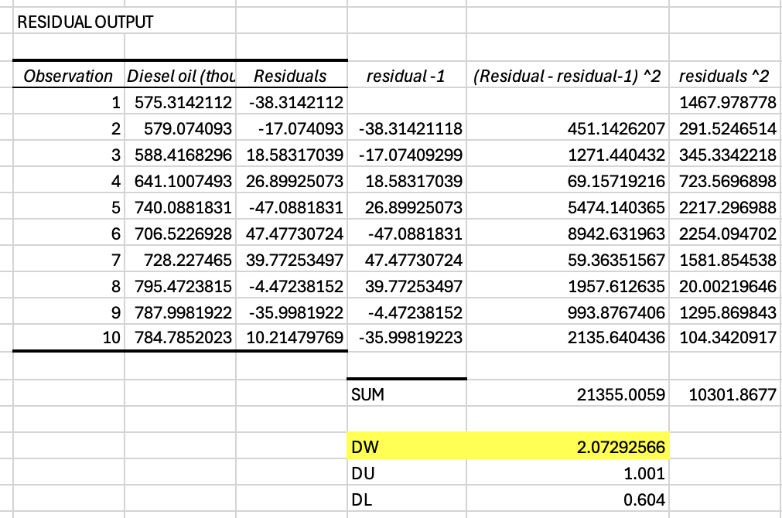
Testing If OLS Assumption Hold
DW value is 2.07, and DW>DU, hence there is no autocorrelation.
DL=1.001
DU=0.604

Slide 13
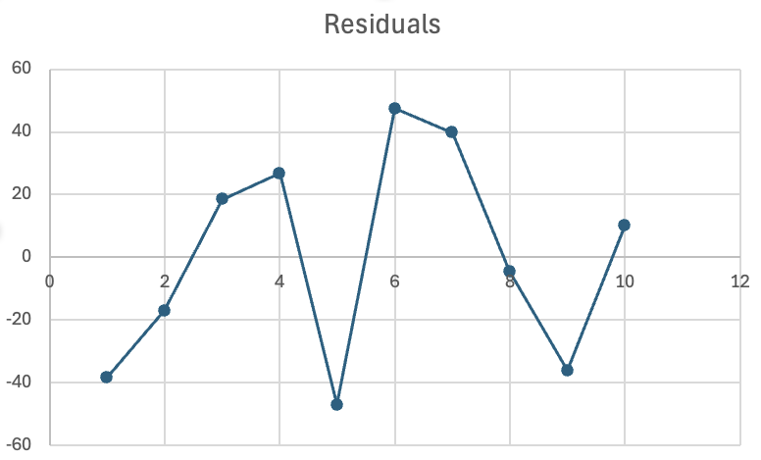
Testing If OLS Assumption Hold

Slide 14
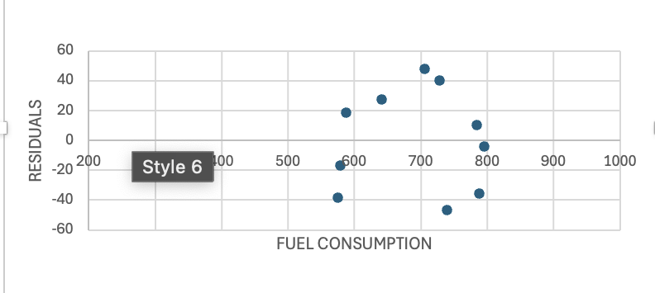
Testing If OLS Assumption Hold
The graph represent Homoscedasticity

Slide 15
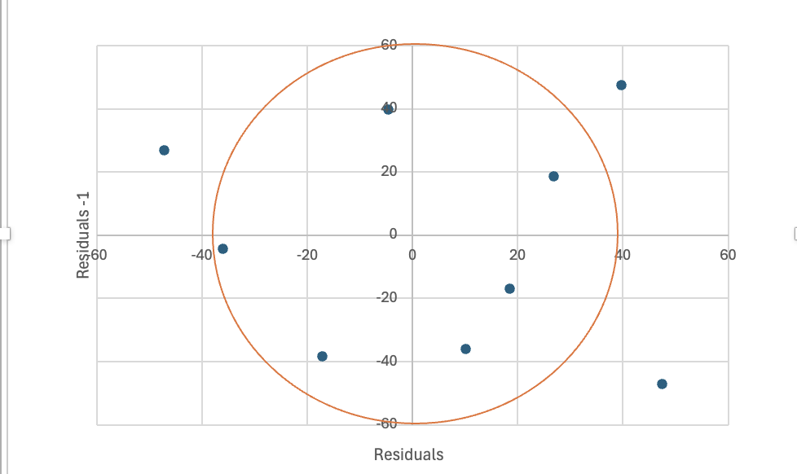
Testing If OLS Assumption Hold
The graph represent there is no autocorrelation

Slide 16
Coefficient Of Determination
SUMMARY OUTPUT
Regression Statistics
Multiple R | 0.93536336
R Square | 0.87490461
Adjusted R Square | 0.85926769
Standard Error | 35.8850033
Observations | 10
R^2 is 0.87, which is indicates 87% of the data fits of the model .
Standard Error: 35.8, Represents the average distance that the observed values fall from the regression line. A smaller standard error relative to the range of the dependent variable suggests a more precise estimate.
SD= SE × 𝒅𝒇
𝒅𝒇 𝒓𝒆𝒔𝒊𝒅𝒖𝒂𝒍= n-2
𝒅𝒇𝒓𝒆𝒔𝒊𝒅𝒖𝒂𝒍 = 10-2 =8.
SD= SE × 𝒅𝒇
SD=35.88 x 10 = 287.04.
Standard Deviation=287.04

Slide 17
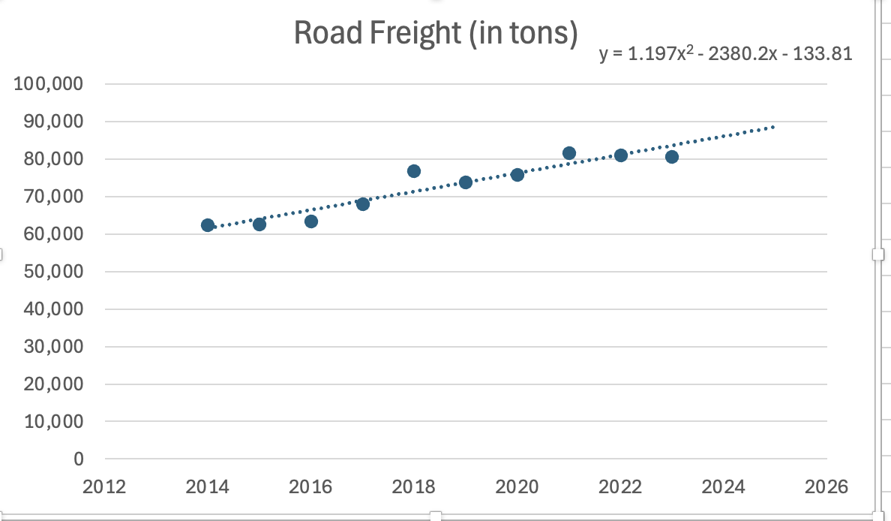
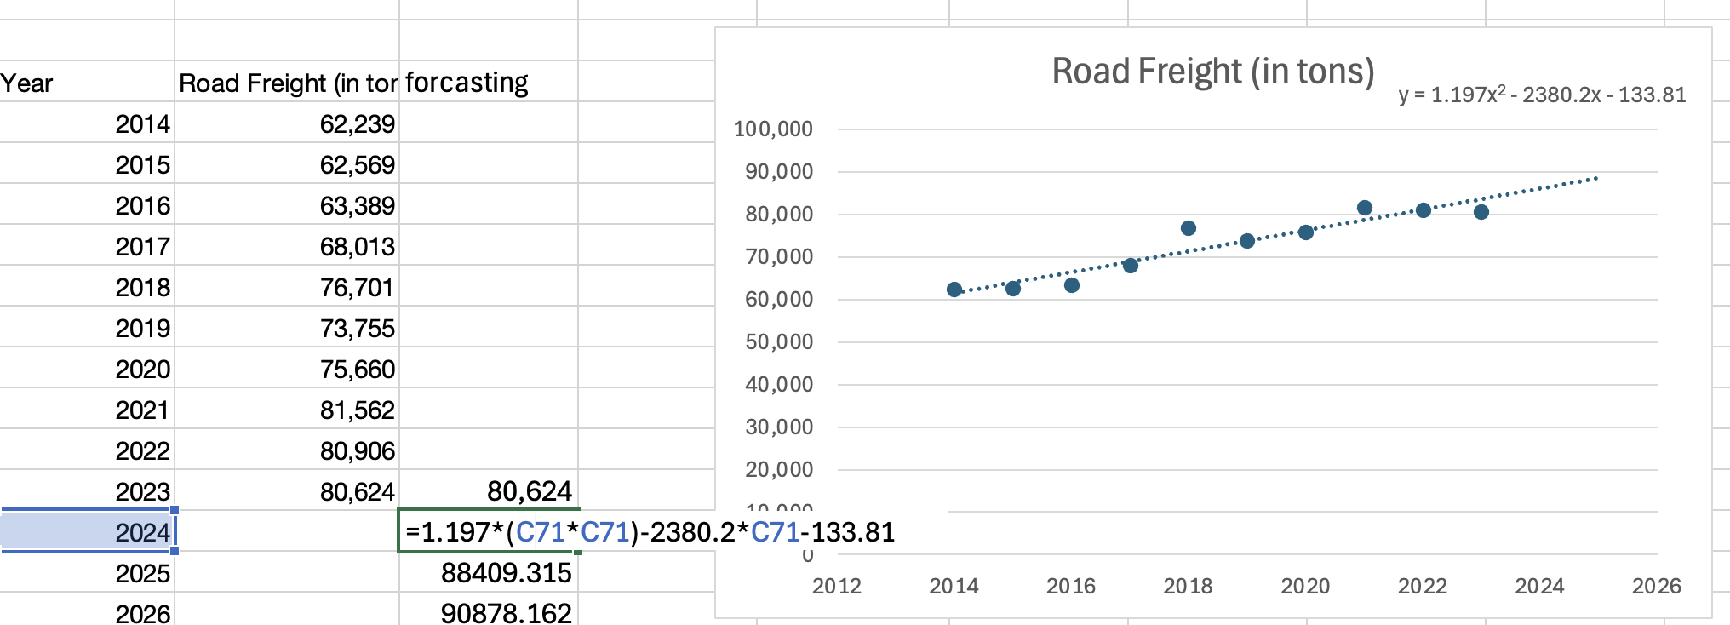
FORCASTING
Year | Road Freight (in THOUSAND tons)
2014 | 62,239
2015 | 62,569
2016 | 63,389
2017 | 68,013
2018 | 76,701
2019 | 73,755
2020 | 75,660
2021 | 81,562
2022 | 80,906
2023 | 80,624

Slide 18
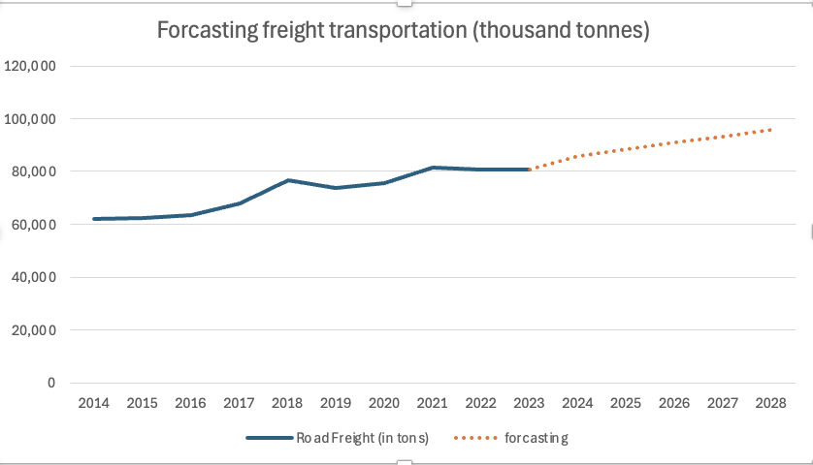
FORCASTING
Year | Road Freight (in tons)
2014 | 62,239
2015 | 62,569
2016 | 63,389
2017 | 68,013
2018 | 76,701
2019 | 73,755
2020 | 75,660
2021 | 81,562
2022 | 80,906
2023 | 80,624
2024 | 85942.862
2025 | 88409.315
2026 | 90878.162
2027 | 93349.403
2028 | 95823.038

Slide 19
Conclusion
The regression analysis indicates that there is a strong and statistically significant positive relationship between freight transportation (in thousand tons) and fuel consumed . The model explains a substantial portion of variance in the dependent variable, making it a reliable tool for predicting outcomes based on road freight volume.
The relationship between fuel consumption and freight transported based on the analysis is strong
With the help of Durbin Watson Statistic, the residual output shows no autocorrelation
Residuals are constant and normally distributed conforming the assumption of homoscedasticity
This indicates that the data fits perfectly and hence, if one variable increases so does the other variable>

Slide 20
Thank you for your attention!

